Slide 1
Lecture 13: Minimization of DFA
Agenda:
DFA Minimization with Table Filling Method (My Hill Nerode Theorem)
Examples of DFA Minimization
Presented by
Prof. Vaibhav Narayan Chunekar
K. J. Somaiya College of Engineering, Vidyavihar, Mumbai

Slide 2
Table Filling Method Steps
Draw table for all pairs of state(P,Q)
Mark all pairs where P ∈ F & Q ∉ F or vice versa (Distinguishing States)
If there are any unmarked pairs(P,Q) such that δ(P, x) or (Q,x)is marked then marked (P,Q) where x is input symbol.
Repeat step 3 until No More Marking can be made/possible.
Combine all the unmarked pairs ( Non Final and Final Should be separated one)and make them a single state in the minimized DFA.

Slide 3
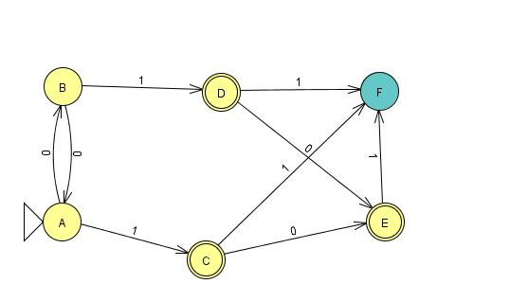
Example 1

Slide 4
Table Filling Method
B | YES
C | X | X
D | X | X | ?
E | X | X | YES | YES
F | X | X | X | X | X
 | A | B | C | D | E

Slide 5
Check for Marking Pairs
δ( A,0)= B δ (B,0)= A
δ( A,1)= C δ (B,1)= D
CHECK ➔AB & CD are Unmarked? ➔ unMarked ➔ Hence unmarked AB
Similar Others....
A,0= B F,0=F BF= NM
A,1 = C F,1=F CF=M
B,0= A F,0=F AF= NM
B,1 = D F,1=F DF=M

Slide 6
Check for Marking Pairs
C,0= E E,0=E EE= NM
C,1 = F E,1=F FF=NM
D,0= E E,0=E EE= NM
D,1 = F E,1=F FF=NM
C,0= E D,0=E EE= NM
C,1 = F D,1=F FF=NM

Slide 7
Table Filling Method
B | YES
C | X | X
D | X | X | YES
E | X | X | YES | YES
F | X | X | X | X | X
 | A | B | C | D | E

Slide 8
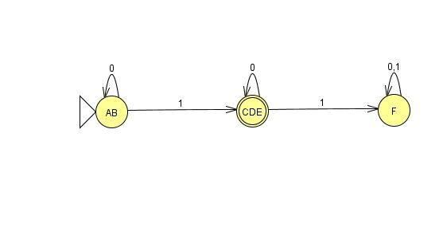
Minimized DFA

Slide 9
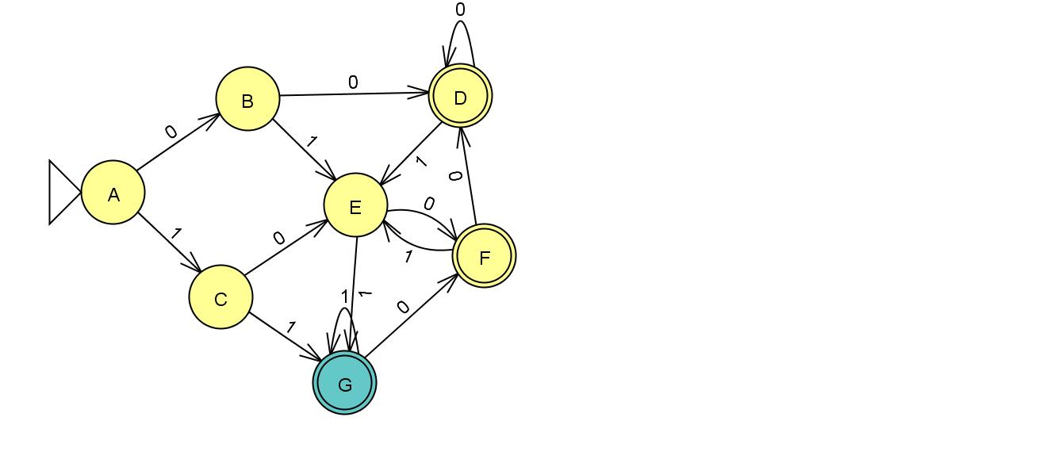
EXAMPLE 2

Slide 10
TABLE FILLING METHOD
A
B | ?
C | ? | ?
D | X | X | X
E | ? | ? | ? | X
F | X | X | X | ? | X
G | X | X | X | ? | X | ?
 | A | B | C | D | E | F

Slide 11
Check for Marking Pairs
δ( A,0)= B δ (B,0)= D
δ( A,1)= C δ (B,1)= E
CHECK ➔BD & CE are marked OR UNMARKED? ➔ Marked ➔ Hence marked AB
Similar Others....

Slide 12
TABLE FILLING METHOD
A
B | X
C | X | X
D | X | X | X
E | X | X | YES | X
F | X | X | X | YES | X
G | X | X | X | X | X | X
 | A | B | C | D | E | F

Slide 13
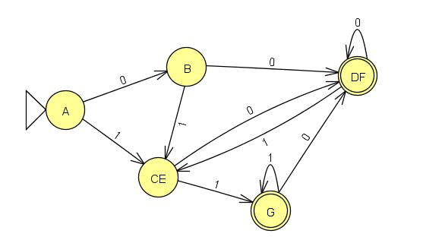
Minimized DFA

Slide 14
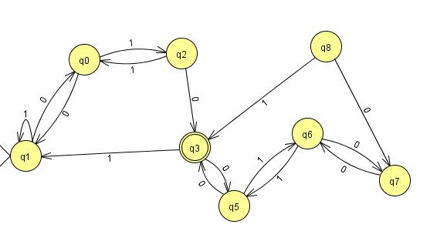
Home Assignment:
Construct Minimized DFA using the following DFA:

Slide 15
Thanks !!! Any ????

